Slide 1





NEURAL NETWORKS EXPLAINED
How it works behind AI
May 2020
Thomas de Mareuil

Slide 2
AGENDA
INTRODUCTION
DEEP LEARNING & NEURAL NETWORKS
CONVOLUTIONAL NEURAL NETWORKS (CNN)
RECURRENT NEURAL NETWORKS (RNN)
OTHER TYPES OF DEEP LEARNING MODELS
APPENDIX

Slide 3
1
INTRODUCTION
Machine Learning overview
Why do we need neural networks?

Slide 4
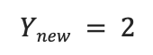
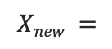
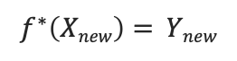
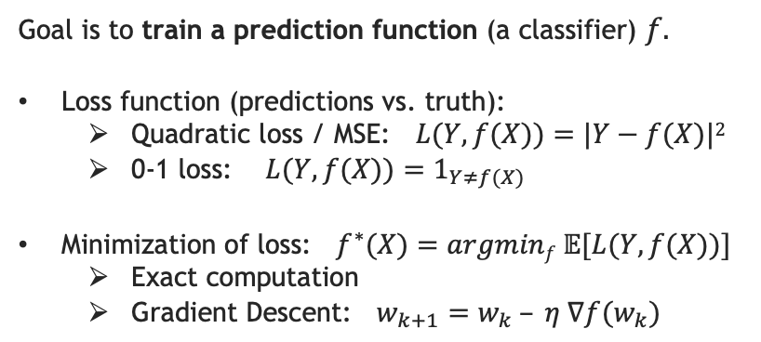
MACHINE LEARNING OVERVIEW – THE SUPERVISED LEARNING FRAMEWORK
Most of what we call today “machine learning”, “deep learning” or “AI” is based on the simple principle of supervised learning:
Training data
Learning algorithm
Data points (X_{i})
Labels (Y_{i})
Goal is to train a prediction function (a classifier) $f$.
Loss function (predictions vs. truth):
Quadratic loss / MSE: $L(Y, f(X))=|Y−f(X)|2$
0-1 loss: $L(Y, f(X))=1_{Y≠f(X)}$
Minimization of loss: $f^{∗}(X)=argminf 𝔼[L(Y, f(X))]$
Exact computation
Gradient Descent: $w_{k+1}=w_{k} – η ∇f(w_{k})$
0
①
TRAINING
1
2
3
4
New input
Classifier
Label
②
PREDICTION
$$Xnew =$$
$$f^{∗}\left(Xnew\right)= Ynew$$
$$Ynew = 2$$

Slide 5
A COMPREHENSIVE VIEW OF MACHINE LEARNING
Here is just an overview of most machine learning fields. We’ll see that deep learning / neural nets can improve on almost all of them!
Type of learning
Categories of algorithms
Classification
Linear Discriminant Analysis (LDA)
Support Vector Machines (SVM)
Naive Bayes
Nearest Neigbour
Logistic & Softmax Regression
Supervised Learning
Regression
Linear Regression
Support Vector Regression
Decision Trees
Ensemble & Boosting Methods
+ in (almost) all tasks
Develop predictive models based on input & output data
Regularization (Lasso, Ridge)
Time series forecast
Autoregression (VAR, ARIMA)
Exponential smoothing (TBATS)
ARCH models
Bayesian models (Prophet)
Machine Learning
Kernel trick
Clustering
K-means
Hierarchical clustering
Gaussian Mixture Models
Hidden Markov Models
Expectation Maximization
Unsupervised Learning
Dimensionality reduction
Singular Value Decomposition (SVD)
Principal Component Analysis (PCA)
Topic Extraction (LDA)
Multi-dimensional Scaling (MDS)
Canonical Correlation Analysis (CCA)
Discover an internal representation based on input data only
Reinforcement Learning
Adversarial Learning
Semi-supervised
Learning
+ Other research fields
Learn from failure
Try to fool the model
Auto-label data

Slide 6


WHY DO WE NEED DEEP LEARNING & NEURAL NETWORKS?
More complex tasks: big data (more inputs), distributed computing
Higher performance: more parameters, non-linear mappings
Special types of data: images, videos, text, speech…
Deep learning and its tools (neural networks, gradient learning) can be used in almost all the fields of machine learning presented in the previous slide (supervised, unsupervised, reinforcement, etc.)!

Slide 7
DEEP LEARNING & NEURAL NETWORKS
2
History
Learning methods
Implementation with Python

Slide 8
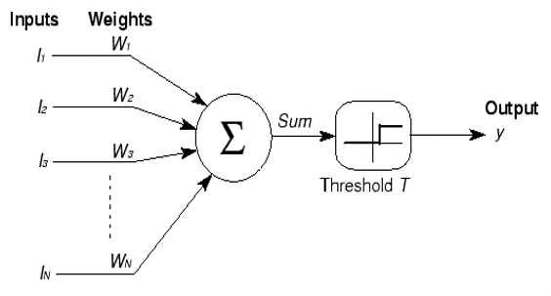
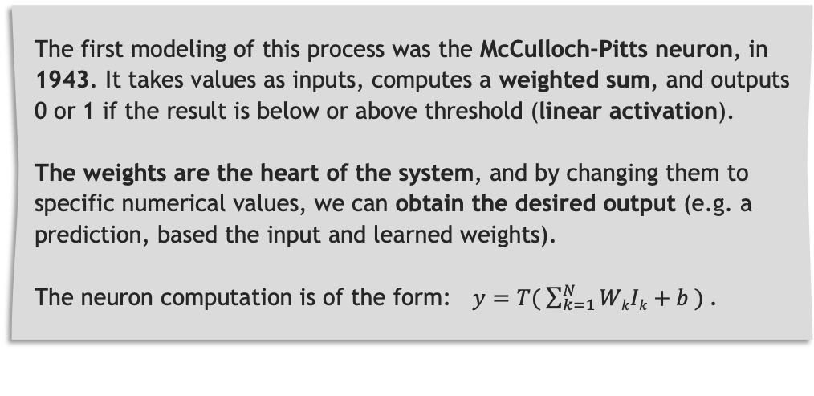
THE HISTORY OF AI AND NEURAL NETWORKS: NOT A RECENT IDEA
Unsurprisingly, the initial idea of neural networks was to simulate how neurons in the brain function.
Basically, a neuron is a cell that receives an input signal, transforms it, and outputs another signal.
Same with an artificial neuron: it receives data as an input, performs computations on it, and outputs another value. It also includes an activation threshold, to determine if the neuron “fires” – i.e. it outputs a value only if the result of its computations corresponds to a certain threshold. Basically, a neuron is just a node of functions.
The first modeling of this process was the McCulloch-Pitts neuron, in 1943. It takes values as inputs, computes a weighted sum, and outputs 0 or 1 if the result is below or above threshold (linear activation).
The weights are the heart of the system, and by changing them to specific numerical values, we can obtain the desired output (e.g. a prediction, based the input and learned weights).
The neuron computation is of the form: $y=T( \sum_{k=1}^{N}{WkIk+b ) }$.
A basic McCulloch-Pitts neuron

Slide 9

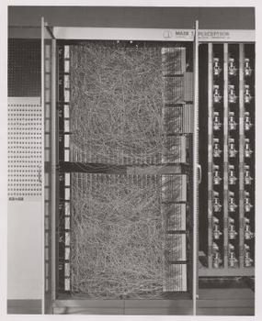
THE FIRST NEURAL NETWORK: THE PERCEPTRON
The Mark I Perceptron, F. Rosenblatt, 1958
The first practical use of these artificial neurons is the Perceptron, developed by F. Rosenblatt in 1958 at Cornell University (link).
His goal was to understand the decision systems in the eye of a fly, which determine its flee response: he installed cameras (the inputs) on a patchboard (to try different combinations) and connected them to processors (for computations) through potentiometers (to adapt weights, using a basic iterative algorithm).
The Perceptron project was funded by the US Navy, who stated at the time:
“The Navy revealed the embryo of an electronic computer today that it expects will be able to walk, talk, see, write, reproduce itself and be conscious of its existence. Later perceptrons will be able to recognize people and call out their names, and to instantly translate speech in one language to speech and writing in another language.”
– Press conference, 7 July 1958, The New York Times.
Limits:
By design, the Perceptron performs only linear computations.
It can only process data with one level of complexity (1 single neuron layer).

Slide 10
GROWING COMPLEXITY: THE MULTI-LAYER PERCEPTRON (1/2)
The complexity problem was quickly solved by stacking several neurons together to form different layers of computations. You then include non-linearity by passing the data through non-linear activation functions.
You get a multi-layer perceptron, which is the basic architecture for all modern neural network. It includes are 3 types of layers:
Input layer
Hidden layer(s)
Output layer
The layer receiving input data and performing the first computations
Input data has to be numerical, i.e. text or images have to be transformed into numerical vectors beforehand
Data pre-processing is usually the most time consuming part in machine learning!
They are each made of several neurons, which perform 1 linear and 1 non-linear (activation) computation (ex: ReLu function)
Each neuron transmits its output to the next hidden layer
The output of a given layer is called a “hidden representation” of our data.
It outputs the desired result, which can be of different sorts
For example, each neuron in the output layer can represent a class and output the probability that the original input belongs to this class.

Slide 11
GROWING COMPLEXITY: THE MULTI-LAYER PERCEPTRON (2/2)
Input layer
Hidden layer(s)
Output layer
The multi-layer perceptron is a fully-connected or ‘dense’ network, i.e. all inputs and outputs are connected together throughout the layers. This will not be the case with other architectures.
In the 60’s, several critics (notably Minsky & Papert, 1969, link), lack of funding and too young technological hardware led to a period where AI and neural networks were put aside: the “AI Winter”.
σ ⁽¹⁾
…
W_{1,1}⁽²⁾
X₁
W_{1,1}⁽¹⁾
neuron
W_{1,2}⁽¹⁾
…
W_{2,2}⁽²⁾
X₂
y₁
Input data
…
Output value(s)
…
…
y₂
…
X_{n}
Notations:
W_{1,2}⁽²⁾: weight applied to the 1st input of the 2nd
neuron in the 2nd layer (including bias b₂⁽²⁾)
σ⁽²⁾: activation function of the 2nd layer (similar for
all neurons in the layer)
Z₂⁽²⁾: input of the 2nd neuron in the 2nd layer
A₂⁽²⁾: output of the 2nd neuron in the 2nd layer, such
that A₂⁽²⁾ = σ⁽²⁾ ( Σ_{k} W_{k,2}⁽²⁾ ・Z_{k,2}⁽²⁾) )
…
Chosen # neurons, possibly embed / flatten layer
Chosen (or random) # of neurons per layer
1 neuron per
possible output

Slide 12
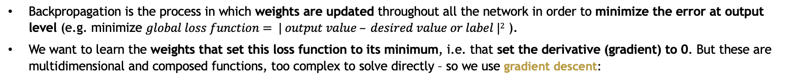
HOW NEURAL NETWORKS LEARN: GRADIENT DESCENT & BACKPROPAGATION
Turning point: the (re)invention and improvement of backpropagation by G. Hinton (1986, link), Y. Le Cun (1989, link) and
Y. Bengio (1998, link), the ‘godfathers’ of deep learning.
Backpropagation is the process in which weights are updated throughout all the network in order to minimize the error at output level (e.g. minimize $global loss function= | output value – desired value or label |2$ ).
We want to learn the weights that set this loss function to its minimum, i.e. that set the derivative (gradient) to 0. But these are multidimensional and composed functions, too complex to solve directly – so we use gradient descent:
Starting from the last layer, we compute the gradient through all layers (i.e. backwards) using the chain rule (derivative of composed functions)
We then move weights slightly in the direction given by the gradient
We repeat this process multiple times until the loss converges (i.e. stabilizes at a minimum value).
We can tune multiple parameters to make the update less computationally expensive and to converge faster: change learning rate (step size) for each update, compute gradients w.r.t. only 1 weight or 1 coordinate at each step, add a momentum term, etc.
Gradient descent

Slide 13




NEURAL NETWORKS IMPLEMENTATION WITH PYTHON
Why Python?
Free and exhaustive libraries, with a very active community
Language flexibility and accessibility (reducing time to code and debug)
Seamless integration with C and C++ code modules
Main frameworks:
TensorFlow: developed by Google, a flexible deep learning library, with implementations of most DL methods and algorithms
Keras: a simplified API on top of TensorFlow
PyTorch: the DL library developed by Facebook
Scikit-learn: the most famous machine learning library, but still useful in DL pipelines for some data pre-processing tasks
Spark MLlib: the Spark framework to scale machine learning / deep learning algorithms on distributed systems (computer clusters)
Specialized libraries:
Natural Language Processing (NLP): NLTK (text processing), SpaCy
Computer Vision: OpenCV, Raster Vision (satellite imagery)
FastAI: simplified API on top of PyTorch

Slide 14
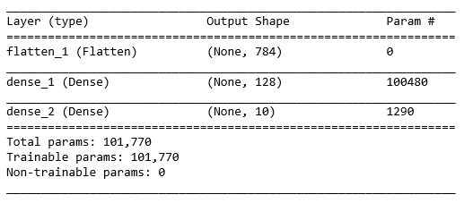
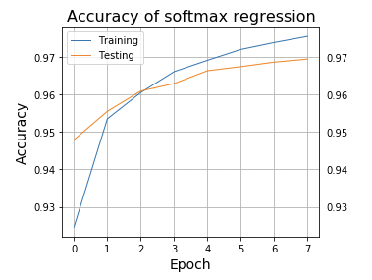
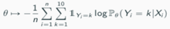
EXAMPLE: HANDWRITTEN DIGITS RECOGNITION (MNIST)
The MNIST dataset (link) is a famous basic example of neural networks application
It contains images of handwritten digits (60k for training, 10k for testing), labelled from 0 to 9
A simple model we could use is: a flattening layer (to convert each image to a vector of numbers), 1 dense hidden layer with ReLu activation, and 1 dense output layer with 10 neurons and softmax activation, which outputs the probability for each of the 10 classes:
Image sample –
28x28 pixels each, 1 channel (gray)
This model relies on more than 100k parameters (weights) which are updated using gradient descent, to minimize the loss function (negative loglikelihood : )
For training, the gradient is computed using batches of 32 samples (up to the 60k samples), and model performance is assessed using the 10k test samples. The whole data set is used 8 times – in the graph you can see how the model learns and improves accuracy.

Slide 15
CONVOLUTIONAL
NEURAL NETWORKS (CNN)
3
Architecture
Famous CNNs
Examples

Slide 16

CONVOLUTIONAL NEURAL NETWORKS (CNN): A SPARSE ARCHITECTURE FOR SPATIAL STRUCTURE RECOGNITION
A problem with the MLP (or “feed-forward”, “dense” network) is that it doesn’t take into account the spatial organization of data – e.g. if pixels values are permuted, the output remains the same, while the image is actually very different.
CNNs tackle this problem by applying convolutions to the data grid. The idea is that a “filter”, or “kernel” (a small square matrix of numbers, for ex. of size 3x3) is moved all along the image, and applies each time some computations to the area it covers.
Depending on the filter, the output represents a special feature of the image - for example, a filter can apply weights such that it keeps only the pixel values corresponding to horizontal lines.
With different filters you can detect different “low-level” features (points, corners…), and when you put several convolutional layers successively, in a deep network, you end up detecting more complex (“high-level”), combined features.
Thanks to backpropagation, your network can learn the filter weights that reveal the most relevant features for your problem. For example, if your goal is to detect panels for an autonomous vehicle, you feed your model with labelled images, and by minimizing the prediction error it learns how to detect circles and rectangles !

Slide 17
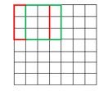
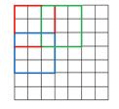
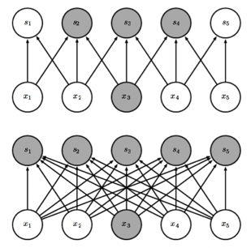
CONVOLUTIONAL NEURAL NETWORKS (CNN): A SPARSE ARCHITECTURE FOR SPATIAL STRUCTURE RECOGNITION
You can adapt many parameters to make sure the network performs well:
Kernel size and stride: you can adjust the size and ‘speed’ at which the filter moves.
Pooling: after scanning an image, you can average results 2 by 2 (2x2 AvgPooling), or you can keep only the maximum values (MaxPooling), in order to reveal only the most important features (and resize the output by the way).
Dropout: random killing of some neurons throughout the network, in order to add randomness and avoid “overfitting” the training data (more robust generalization)
Stride = 1 vs. stride = 2
Each convolutional layer (including filter Convolutions, + Pooling, + non-linear Activation as usual) outputs a new representation of the image, called a feature mapping, and can transmit it to the next layer for further analysis.
Another great advantage of CNNs is their sparse architecture:
In a convolution with a kernel of width 3, only 3 outputs are affected by the input x₁, vs. when we use complete matrix multiplication all inputs are connected to all outputs. We say that the connectivity is sparse vs. dense.
It results in a lot less parameters, improving memory and computation speed.
Sparse vs. dense architecture

Slide 18
FAMOUS CNNs – THE IMAGENET CHALLENGE
The first famous CNN is LeNet (link), by Y. LeCun in his landmark 1998 article about character recognition (MNIST).
The next famous CNNs are all outcomes of the “ImageNet” challenge, a global open competition (started in 2010, annually) that aims at advancing research in AI. It contains +14M images with +20k different classes to predict. Major milestones in the competition are:
AlexNet (Univ. of Toronto, link): winner in 2012 with a test accuracy of 84.6%, +10.8 ppts better than the runner-up. This was made feasible due to the use of Graphics processing units (GPUs, an essential ingredient of the deep learning revolution) which allow to train more complex models thanks to parallelization properties.
VGG-16 (Oxford, link): winner in 2013 with 92.7% accuracy, another big leap forward, thanks to a deeper architecture.
GoogleNet (Google, link) winner in 2014 with 93.3% accuracy, made of 22 layers and a new building block called “inception module”.
ResNet (Microsoft, link): winner in 2015 with 96.4% accuracy, very deep (152 layers) but still not-so-expensive to train thanks to “residual blocks”, which allow to skip certain layers (see architecture in Appendix).
DenseNet (Facebook, link, 2017): improvement on ResNet thanks to alternating conv and dense blocks, with overall less parameters (see architecture in Appendix).
ImageNet models accuracy and computation speed

Slide 19
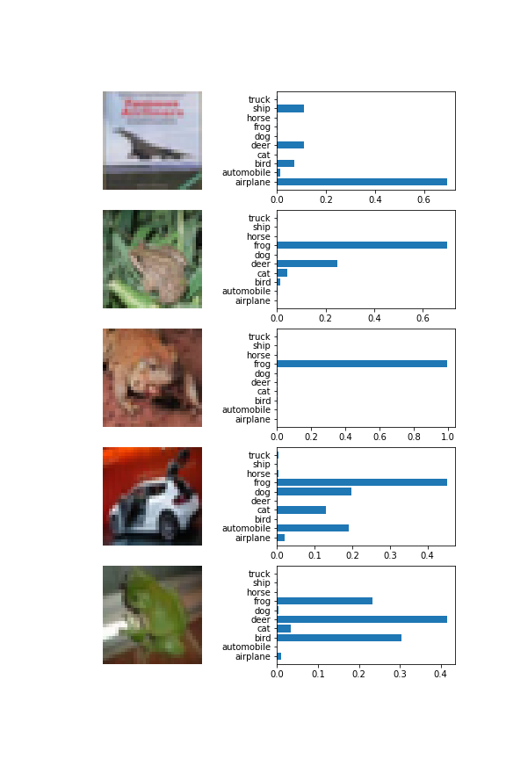
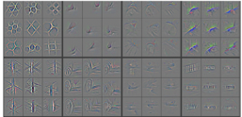
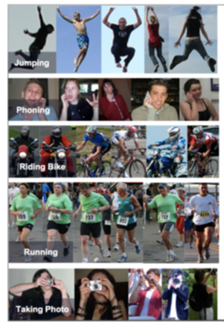

EXAMPLE (I): IMAGE CLASSIFICATION
The most straightforward application of CNNs might be image classification: you give a model thousands of images with their labels (classes), it learns how to recognize them and outputs the class probability.
Output probabilities on the “CIFAR-10” (10 classes) dataset:
Feature mapping: what a model “sees” (output of AlexNet’s 3rd conv layer)
Frame annotation based on recognized content:

Slide 20

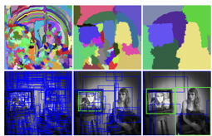
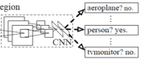
EXAMPLE (II): OBJECT DETECTION
Object detection goes further than simple classification by defining a bounding box around the recognized object.
A popular approach is the Region-based CNN model (R-CNN, 2014, link):
First, the model determines where the objects could be located in the image, using a “selective search” algorithm which iteratively groups together similar pixels.
Then it puts a bounding box around each category-independent region proposal, and uses a CNN to classify it.
The “You Only Look Once” (YOLO, 2015, link) and “Single Shot Detector” (SSD, 2016, link) models use the same principle, but they predict bounding boxes and class probabilities from the full image in a single, trainable pipeline.
Therefore, they are much faster and can easily process video:
Selective search iterative process
CNN region classification

Slide 21
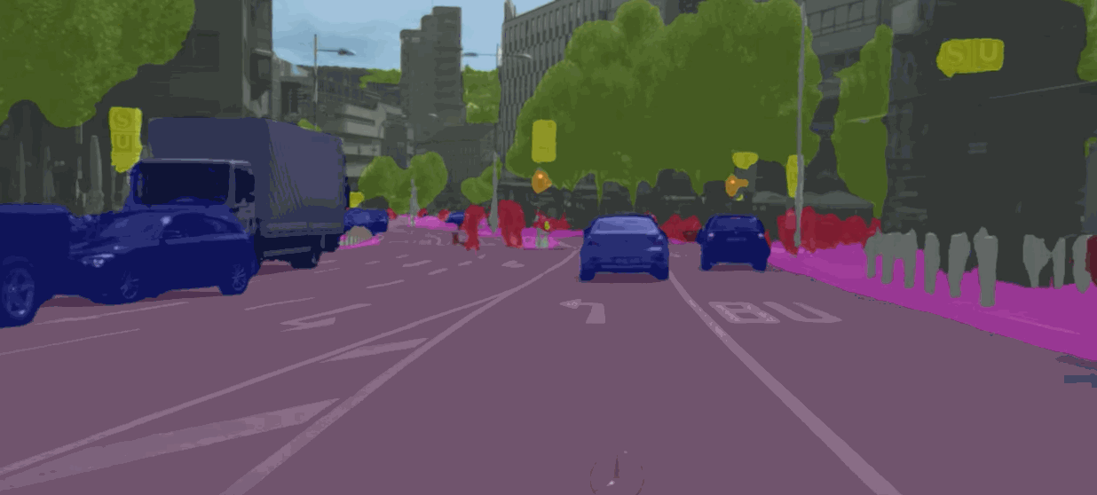
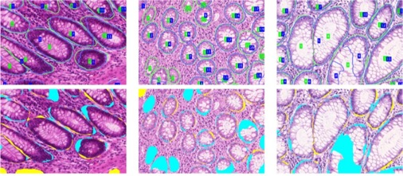
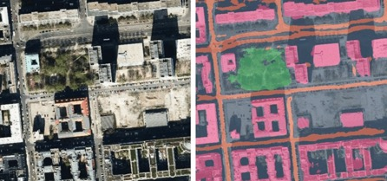
EXAMPLE (III) – SEMANTIC SEGMENTATION
Semantic segmentation goes even further by classifying each individual pixel in an image, in order to outline the shape of the recognized objects.
Semantic segmentation models were pioneered by SegNet (2015, link) and are now used in multiple fields:
Autonomous vehicles (ICNet, 2017, link and gif on the right)
Satellite image analysis
Medical image analysis (U-Net, 2015, link, and FCN, 2017, link)
And a lot more!
Real-time video segmentation
Histopathological tumor detection
Satellite image analysis

Slide 22
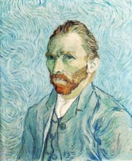
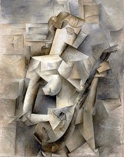
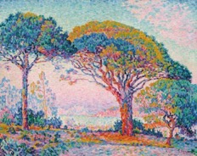



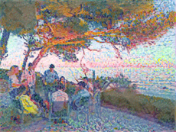
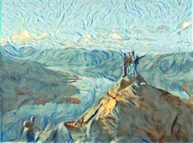
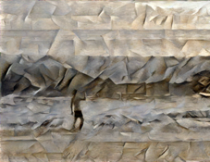
EXAMPLE (IV): NEURAL STYLE TRANFER
Neural Style Transfer (NST) uses CNNs to apply a new artistic style to any image.
The idea is that it is possible to use CNN feature maps to separate the style and the content representation from an image. Here, I ran a ‘content’ image and a ‘style’ image through the pre-trained VGG19 to obtain their content and style representations.
I then defined a dual loss function, which corresponds (1) to the difference in style between the ‘input’ and the ‘style’ image, and (2) to the difference in content between the ‘input’ and the ‘output’ image.
Minimizing this function with gradient descent transfers style from one image to the other, while making sure content isn't lost in the process.

Slide 23
RECURRENT
NEURAL NETWORKS (RNN)
4
Architecture
Famous RNNs
Examples

Slide 24
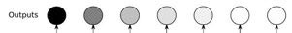
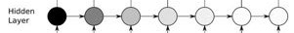
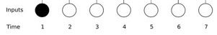
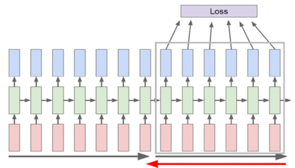
RECURRENT NEURAL NETWORKS (RNN): A ‘RECURRENT’ ARCHITECTURE FOR SEQUENTIAL DATA ANALYSIS
Previously seen networks are not so good at dealing with sequential or “temporal” data, because (1) they lack “memory” (i.e. they don’t consider the inputs as connected together) and (2) they have a fixed architecture (fixed input and output sizes).
RNNs solve this problem thanks to an architecture where neurons in the hidden layers are connected together. They not only transmit their output to the next layer, but also to the neuron next to them.
As a consequence, RNNs can take into account past instances of data to predict future instances of a variable. Each output is computed based on inputs + on the “state matrix” corresponding to the outputs of the past steps. It works especially for stock market forecast, next-word prediction, etc.!
This recurrent connectivity is even more biologically realistic. RNNs can also be mixed with CNN layers to get the best of both worlds.
RNN structure (↑) and learning process (↓) for sequential data
RNN structure for sequential data
When training RNNs, 1 gradient step is very costly, as it requires to pass through the entire connected dataset. You are also at risk of the “vanishing gradient” problem: too many derivations bring gradients to 0 (i.e. no more weight update). So you usually work with batches of data steps. See appendix for maths!

Slide 25
FAMOUS RNNs (1/2) – LONG SHORT-TERM MEMORY CELLS (LSTM)
The LTSM cells (invented in 1997 – link, improved in 2015 – link) and their close cousin the “Gated Recurrent Units” (GRU, 2015 - link) are special types of neurons that use the principle of “gates” to regulate the flow of information and improve the way the network “remembers”. This one is a little complex, stay focused!
Each LSTM neuron includes 2 data flows: the “cell state” (result of the computations of a single neuron, i.e. a sort of “short term memory”) and the “hidden state” (outputs passed and updated from cell to cell, i.e. a sort of “long term memory”).
Operations in an LSTM unit
h_{t}
(Potential) output to next layer
Previous cell state
c_{t-1}
c_{t}
New cell state output
At the entry of each cell, the “forget gate” receives the past hidden state and new data, and eliminates part of them.
The past hidden state and the new data also take a 2nd way to the “input gate”, which runs several computations on them.
The results of the 2 firsts gates are combined with the previous cell state (line on top) to form the new cell state.
Finally, the “output gate” combines the new cell state and the inputs from the start (hidden state + new data) to produce the new hidden state (updated long-term memory).
Previous hidden state
h_{t-1}
h_{t}
Updated hidden state
Forget gate
Input gate
Output gate
x_{t}
New data
*See appendix for animated version

Slide 26

FAMOUS RNNs (2/2) – LONG SHORT-TERM MEMORY CELLS (LSTM)
In short, the forget gate decides what is relevant to keep from prior steps. The input gate decides what information is relevant to add based on computations at the current step. The output gate uses current and past states to perform the update of the hidden state.
This system is very efficient: if new data was important, the gate weights (which are learnt during training) will make sure that it persists and becomes part of the long-term state matrix (the hidden state) and consequently weighs more in the next cell. Conversely, non-essential information is eliminated (see example on right). This helps to find relevant patterns in sequential data.
→ Forget gate
→ Input gate – part 1
We can also remark that with LSTM, the hidden state output passed to the next cell (i.e. next time step) is a weighted average of the previous hidden state and of the newly created cell state – therefore, it is bounded, which (partly) solves the vanishing gradient problem (gradient kept away from 0 when computing through time steps, which used to slow down learning and to shrink long term information).
→ Input gate – part 2
→ New cell state
→ Output gate – part 1
→ Output gate – part 2:
new hidden state
Each gate includes weighted average operations (weights learnt during training) and of a non-linear activation function.
LSTM equations

Slide 27
EXAMPLE (I): WORD EMBEDDINGS FOR SENTIMENT ANALYSIS
See X course and project

Slide 28
EXAMPLE (II): IMAGE CAPTIONING WITH ATTENTION MECHANISM
See DenseCap model in X course

Slide 29
EXAMPLE (III): SPEECH SYNTHESIS
See WaveNet model in X course

Slide 30
OTHER TYPES OF DEEP LEARNING MODELS
5
Recommender systems
Transformers / Autoencoders
Generative Adversarial Networks (GANs)
Self-Organizing Maps (SOMs)
Graph & random walk methods

Slide 31
NEURAL NETWORKS TO TRAIN RECOMMENDER SYSTEMS
The classic recommender system architecture is the Collaborative filtering model. It is based on factorization of a matrix compiling all explicit feedbacks from users – for example, all movie ratings per user.
Netflix organized a famous competition in 2006-2010 to improve state-of-the-art in this domain.
Today, the most recent approaches use neural networks to include, next to explicit feedback, implicit feedback, content features and content/user/system metadata, which are all embedded and fed to neural networks, whci provide even more accurate recommendations.
https://towardsdatascience.com/building-a-recommendation-system-using-neural-network-embeddings-1ef92e5c80c9

Slide 32
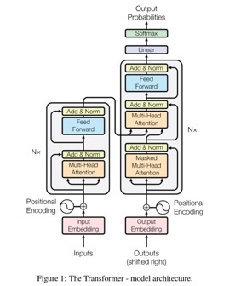
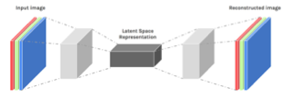
TRANSFORMERS, AUTOENCODERS AND SEQ2SEQ ARCHITECTURES
FOR MACHINE TRANSLATION
Autoencoders are a type of architecture composed of an encoder and a decoder modules. It includes sequence to sequence models, particularly useful in translation tasks.
Autoencoders — Representing Data in a Compressed Way
Most neural networks take in data and make some types of decisions. Autoencoders have a different task, and that is to figure out a way to compress data but maintain the same quality.
Traditionally in machine learning, the labels attached to our data are different and the goal of the neural network to produce. In an auto encoder, the labels are the same as the inputs.
So, in this architecture, you have an identical input and output layer. The hidden layer is smaller than the input and output layer (in terms of nodes) and is called the “bottle neck”. Since the bottleneck is smaller, it is forced to find a way to compress the original data and put it back in the output layer. This compression is often better than conventional means because it can still maintain high quality.
Attention Is All You Need
https://arxiv.org/abs/1706.03762
Multi-head attention layers
https://medium.com/inside-machine-learning/what-is-a-transformer-d07dd1fbec04

Slide 33
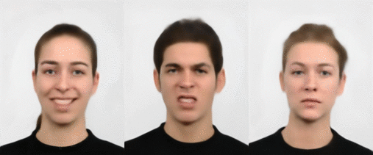
GANs FOR CONTENT CREATION
“ThisPersonDoesNotExist.com uses AI to generate endless fake faces”, 2019

Slide 34
SELF-ORGANIZING MAPS FOR UNSUPERVISED CLUSTERING

Slide 35
GRAPH METHODS & RANDOM WALKS FOR NODE DATA ANALYSIS

Slide 36
6
APPENDIX
More information!

